Slide 1
Project Choice: (First Choice)
PEER PLATFORM

Slide 2
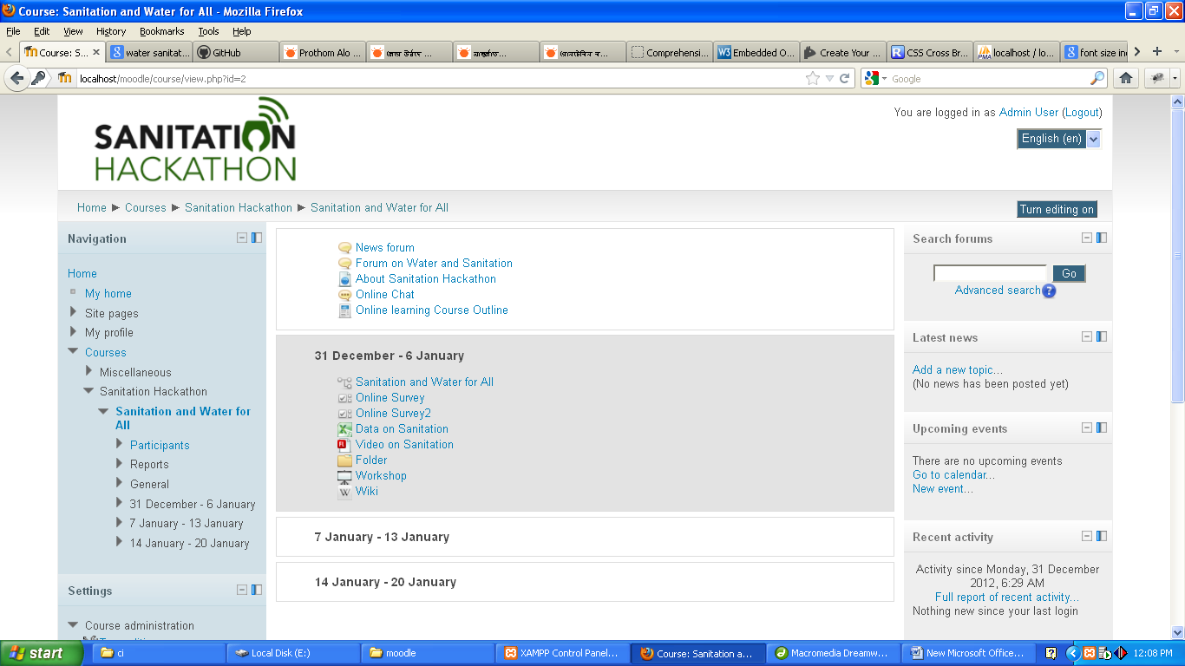
Screen Shot.

Slide 3
Project Summary:
To create a simple Bangla IT platform enabling local governments to share their good sanitation practices and access the good practices of others.

Slide 4
Project Features:
Local govt. can build and upload Lessons, documents, File/Folders etc. about their good sanitation practices and access the good practices on Bangla/english IT based online learning system (LMS) website.
Local govt. can build Forum, Chat, blog etc. to share their good sanitation practices to public users also.
Public users are able to gather knowledge through lessons/others tools, give answers any quiz type questions, assignments, join to online survey, workshop etc. on good Sanitation practices. Users can comments on lessons, get their performance grade reports, certificate etc. after successful completion of online learning course.
Every online lessons can build using text, images, audio, video, different types of quiz questions etc.
Local govt. can create area/capacity (children/adults) based users group/team to access the different online learning courses on good Sanitation and water issues.

Slide 5
Vision within 1 month
This is one of best tools (CMS:Moodle) on Online Learning System (LMS) to create a Bangla/English IT platform enabling local governments to share their good sanitation practices and access the good practices of others. So Local govt. can utilizes this systems to overcome sanitation and water problems easily.
We need within 1 Month to complete the project:
Topics on Sanitation and water issues, referring text audio sound (mp3/swf), video (swf/flv) , images (jpg/png/gif) etc.

Slide 6
Team Info
Team ID: 431
Abul Kashem
Email: kashemsos.base@gmail.com, kashem@baseltd.com ,Mobile: 01717-032290
Khan Shafiqul Islam Murad.
Email: murad@baseltd.com, Mobile: 01712135360
Amit Biswas (team leader)
Email: amit@baseltd.com Mobile No: 01713-144221
Upload Link:
https://github.com/kashemBaseltd/SANITATIONHACKATHONBANGLADESH.git

